Slide 1
OSI Mode
Lecture 5

Slide 2
Definition
The OSI (Open Systems Interconnection) model is a conceptual framework used to understand how different protocols and technologies work together in computer networks.
The OSI (Open Systems Interconnection) model is like a blueprint for how computer networks should work.
It divides network communication into seven layers, each with a specific job.
These layers help devices from different manufacturers talk to each other smoothly.

Slide 3
Importance
Clear Communication: The OSI model is important because it creates a common language for different devices in a network. Ensures that devices from different manufacturers can communicate effectively.It helps them understand and work together, like a universal translator.
Troubleshooting: This makes it easier to build and troubleshoot networks, ensuring they run smoothly. Provides a structured approach to identify and resolve network issues.

Slide 4
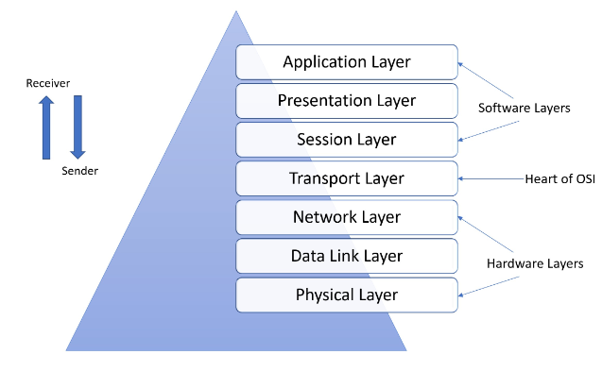

Slide 5
Layers of OSI Model
Layer 7 - Application: Deals with end-user services like email, web browsing, and file transfer.
It is like the front door of your computer. It deals with the software you directly interact with, like web browsers, email, and games. It helps you access information and services on the internet.

Slide 6
Layers of OSI Model
Layer 6 – Presentation:
It is like a language translator for computers. It makes sure data is in a format both devices can understand, handling things like encryption and compression.
It ensures that information sent from one device can be properly received and read by another.

Slide 7
Layers of OSI Model
Layer 5 – Session:
It is like a conversation manager.
It sets up, maintains, and closes connections between applications on different devices.
It ensures that data gets from one place to another reliably and in the right order

Slide 8
Layers of OSI Model
Layer 4 – Transport:
It is like a delivery coordinator.
It makes sure data arrives accurately and in order.
It also checks for any errors and ensures that large messages are broken into smaller pieces if needed.

Slide 9
Layers of OSI Model
Layer 3 – Network:
It is like a GPS for data.
It figures out the best path for information to travel across different networks.
It helps data packets reach their destination, even if they need to go through several stops along the way.

Slide 10
Layers of OSI Model
Layer 2 - Data Link:
It is like a traffic wardon for devices on the same road.
It manages how devices on the same network communicate, using unique codes called MAC addresses.
It ensures data gets to the right place in a local area network (LAN).

Slide 11
Layers of OSI Model
Layer 1 - Physical:
It is like the actual wires and connections in a network.
It handles the physical connection between devices, like cables and switches.
It ensures that data can flow between devices smoothly and reliably.

Slide 12
Understanding Layers with Examples
Application Layer Example: Web browsers, email clients.
Transport Layer Example: TCP (Transmission Control Protocol) ensuring reliable data transfer.
Network Layer Example: Routers making decisions on the best path for data.
Physical Layer Example: Ethernet cables, switches.

Slide 13
Advantages of OSI Model
Interoperability: Enables devices from different manufacturers to communicate effectively.
Modularity: Allows for easy replacement or upgrade of individual layers without disrupting the entire system.
Standardization: Provides a common framework for designing and troubleshooting networks.
Structured Troubleshooting: Helps in identifying and resolving network issues in a systematic manner.
Facilitates Protocol Development: Aids in the creation and understanding of new networking protocols.

Slide 14
Limitations of OSI Model
Theoretical Nature: Can be overly theoretical for practical implementation in some real-world scenarios.
Not Always a Perfect Fit: Real-world network protocols and technologies may not neatly align with the OSI model's seven layers.
Complexity for Beginners: Beginners might find it complex to understand and apply in practical network setups.
Doesn't Address All Aspects: Doesn't cover all aspects of networking, such as hardware specifics or real-time performance requirements.
May Not Reflect Modern Network Architectures: Newer networking technologies and architectures may not fit neatly into the OSI model framework.

